Slide 1

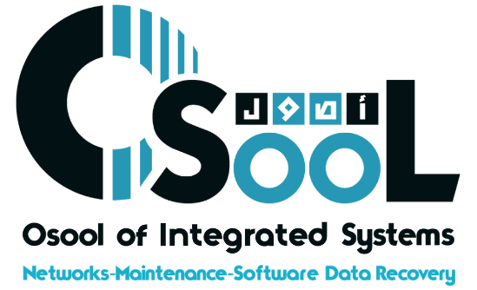







Osool
Data Recovery
Osool Proposal
We recover your data quickly and safely. Your trusted partner in Riyadh.
Presented By:
Mohamed Al-Arini
Our Website
www.datarecovery-sa.com

Slide 2

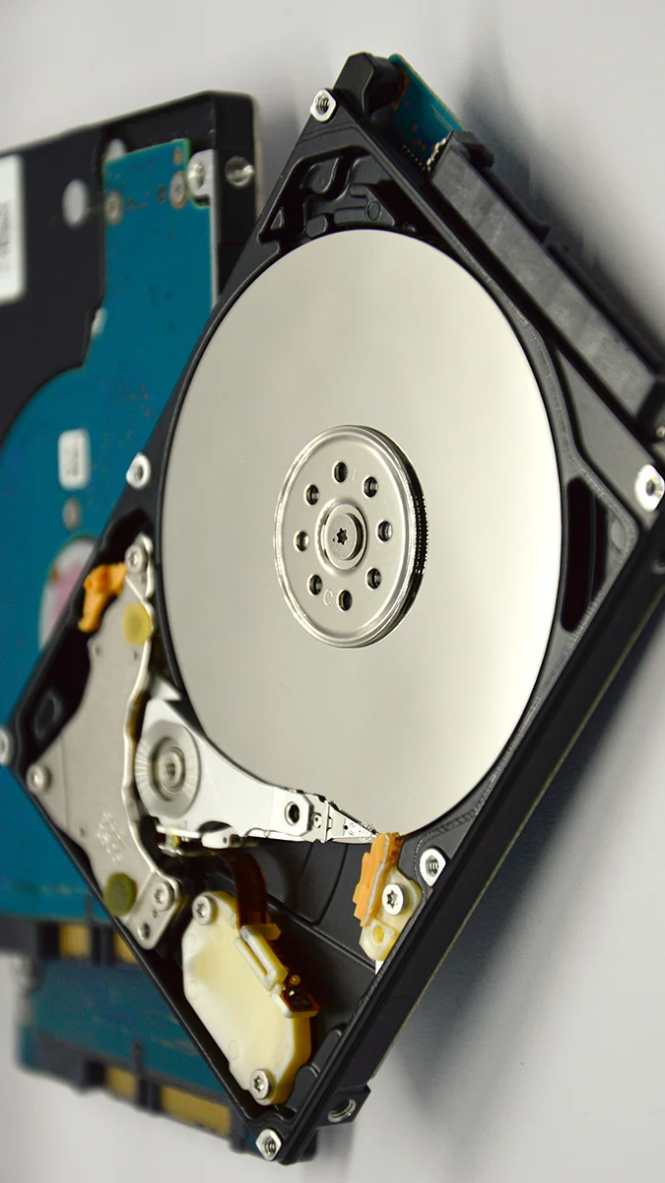




Osool
Data Recovery
About Us
At Osool Data Recovery Company, we are committed to providing leading data recovery solutions with an unparalleled experience of over 18 years. We help companies and individuals recover lost, damaged, or corrupted data from various storage media such as Hard Disk Drives (HDDs), Solid-State Drives (SSDs), RAID systems, databases, and more.
As the leading provider of data recovery services in the Kingdom of Saudi Arabia, we give top priority to security, efficiency, and precision in every recovery process. Whether your data loss is due to accidental deletion, hardware failure, electronic attacks, or ransomware, our team of seasoned experts is ready to recover what matters to you, using the latest technologies and best international practices.
Our Website
www.datarecovery-sa.com

Slide 3


Osool
Data Recovery
What We Do?
We provide you with our extensive experience and advanced technologies to offer comprehensive and reliable data recovery solutions. We fully understand that data loss, whether due to hardware failure, human error, or a complex electronic attack like ransomware, can have significant consequences. We use the latest specialized tools and best global practices to ensure a fast, secure, and seamless recovery process.
01. Disk and SSD Data Recovery
02. Server and RAID Data Recovery
We recover lost data from damaged or failed Hard Disk Drives (HDDs), Solid-State Drives (SSDs), as well as flash media (USB, SD Cards).
Specialized solutions to recover lost data from failed RAID arrays, SAN/NAS systems, and virtual environments like VMware.
03. Ransomware Combat and Data Recovery
04. Database Recovery
Advanced services to recover encrypted files after ransomware attacks, with expertise in removing traces of the attack and restoring access to your systems.
Restoring and repairing your vital databases (SQL, Oracle) and recovering lost files from macOS devices and Apple external storage units.
Our Website
www.datarecovery-sa.com

Slide 4

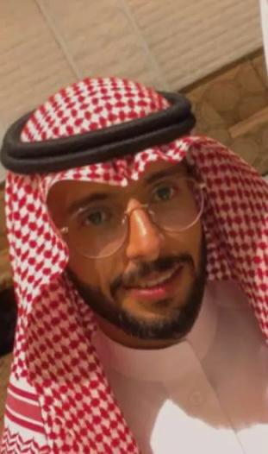

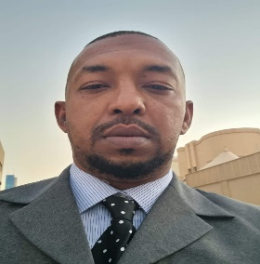
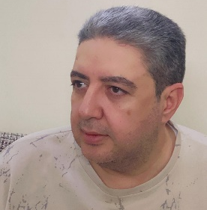
Osool
Data Recovery
Meet Our Team
Mohamed Al-Arini
Chairman of the Board
As Chairman of the Board, Mohamed Al-Arini leads 'Osool' with a clear vision to provide unparalleled data recovery services. The success of the establishment is based on his firm commitment to quality and building strong relationships with clients based on trust and guaranteed results.
Alaa Al-Din Ahmed
Executive Manager
As the Executive Manager, he manages the company's operational processes. With his experience as a mechatronics engineer and his previous work at Motorola, he ensures the application of the highest technical and administrative efficiency standards to provide the best solutions and services to our clients.
Adel Kahil
Head of Research and Development (R&D)
As the Head of R&D, Adel leads the company's innovation efforts. He specializes in finding solutions for the most complex technical problems, including recovering RAID systems and repairing databases (Oracle, SQL), ensuring the delivery of advanced and reliable services to our clients.
Our Website
www.datarecovery-sa.com

Slide 5
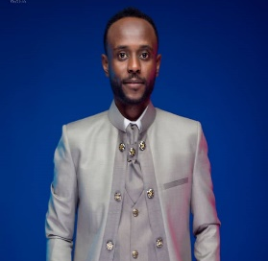
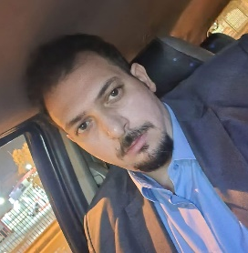

Osool
Data Recovery
Meet Our Team
Hussam Noreen
Sales Consultant
Hussam serves as the primary link between our clients and our technical team. With his experience as a Sales Consultant, he accurately analyzes client needs and provides them with the appropriate consultation and technical solutions, ensuring a smooth and clear experience from the first contact until successful data recovery.
Omar Ghandi
Advertising and Marketing Manager
Omar Ghandi is responsible for managing the company's advertising and marketing strategies. He works to enhance the 'Osool' brand in the market and reach potential customers through multiple channels, highlighting our expertise and ability to recover their most important digital assets.
ZheWen.Wang
Ransomware Combat Expert
ZheWen.Wang is our dedicated expert in confronting ransomware attacks. He has deep experience in analyzing attacks, developing tools to decrypt files, and safely and effectively restoring affected systems, helping our clients recover their vital data without submitting to extortionists.
Our Website
www.datarecovery-sa.com

Slide 6
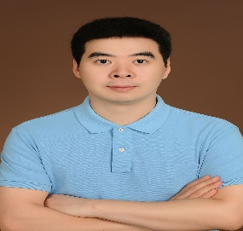
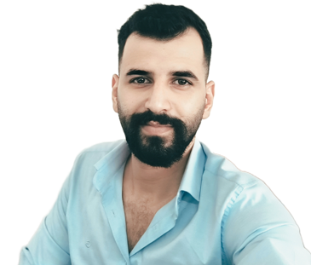
Osool
Data Recovery
Meet Our Team
Jiang Bu
Database Recovery Specialist
Jiang Bu is our expert specializing in the recovery of vital databases. Thanks to his deep experience in systems like Oracle and SQL, he repairs and retrieves data from damaged or corrupted databases, ensuring the business continuity of our clients effectively.
Ali Mohammad
Deep Learning and Technical Support Engineer
Ali Mohamed combines his expertise in deep learning engineering with providing advanced technical support. He works on developing smart and innovative solutions to improve data recovery processes and provides the necessary technical support to ensure our clients have the best possible experience.
Our Website
www.datarecovery-sa.com

Slide 7




Osool
Data Recovery
Why Choose Us
We understand how important your data is, which is why we give you good reasons that make us your ideal partner for its recovery:
Over 18 Years of Experience
Complete Security and Confidentiality
Many years of success and excellence in customer service and complex data recovery, which has established our position as leaders in the field.
We adhere to the highest standards of confidentiality and privacy. Your data is in safe and protected hands throughout all stages of the recovery process.
Experts in Combating Ransomware
Free Evaluation and Recovery Guarantee
Pioneers in developing advanced tools to decrypt ransomware and securely recover encrypted files, without the need to pay the ransom.
We offer a free check, and if we can't recover your data, you won't pay any fees. "Money-back guarantee if we don't recover your data."
Our Website
www.datarecovery-sa.com

Slide 8
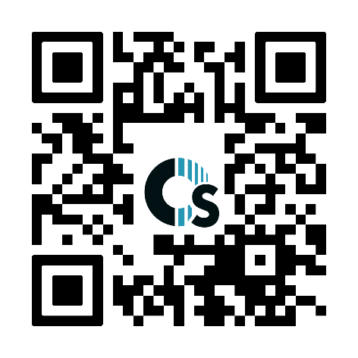


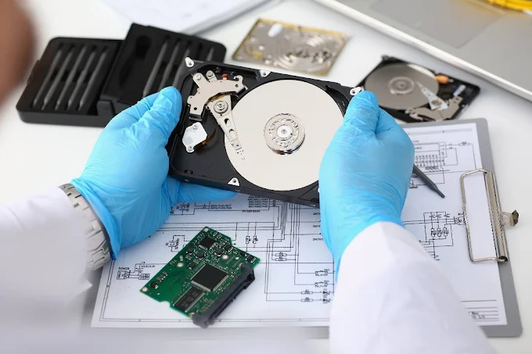



Osool
Data Recovery
Get In Touch!
Saturday - Thursday: 10:00 AM - 10:00 PM
Our Phone
00966531010903
00966553746722
Our Website
www.datarecovery-sa.com
info@datarecovery-sa.com
Our Location: Kingdom of Saudi Arabia - Riyadh - Olaya - Computer Complex, Seven Floor

